Slide 1
2D TRANSFORMATIONS
COMPUTER GRAPHICS

Slide 2
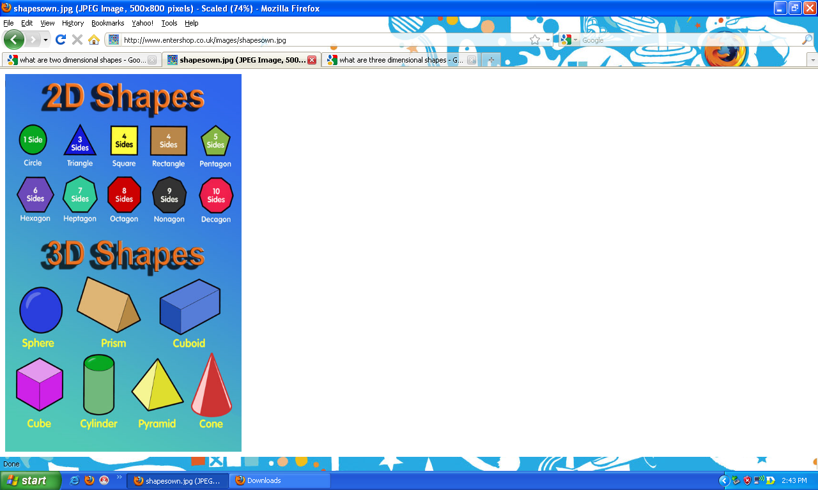

Slide 3
2D Transformations
“Transformations are the operations applied to geometrical description of an object to change its position, orientation, or size are called geometric transformations”.

Slide 4
Why Transformations ?
“Transformations are needed to manipulate
the initially created object and to display the
modified object without having to redraw it.”

Slide 5
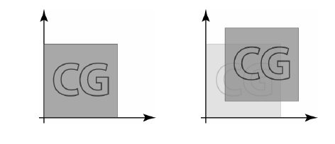
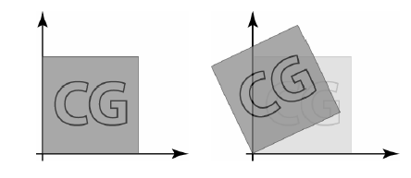
Translation
Rotation

Slide 6
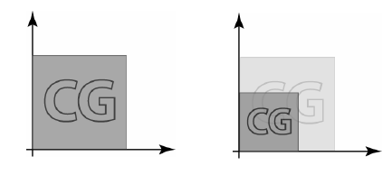
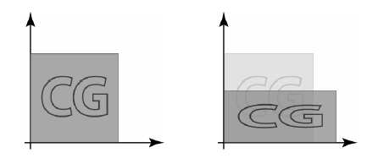
Scaling
Uniform Scaling
Un-uniform Scaling

Slide 7
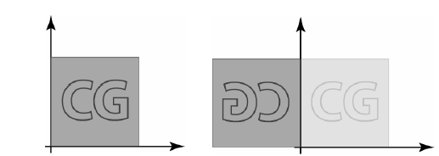
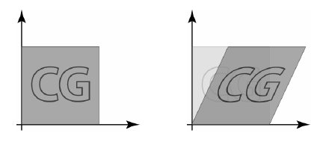
Reflection
Shear

Slide 8
Translation
A translation moves all points in an object along the same straight-line path to new positions.
The path is represented by a vector, called the translation or shift vector.
We can write the components:
p'_{x} = p_{x} + t_{x}
p'_{y} = p_{y} + t_{y}
or in matrix form:
P' = P + T
P'(8,6)
=4
t_{y}
t_{x}
= 6
P(2, 2)
x'
y'
x
y
t_{x}
t_{y}
= +

Slide 9
Rotation
A rotation repositions all points in an object along a circular path in the plane centered at the pivot point.
First, we’ll assume the pivot is at the origin.
P
θ
P

Slide 10
Rotation
Review Trigonometry
=> cos φ = x/r , sin φ= y/r
  x = r. cos φ, y = r.sin φ
P’(x’, y’)
  => cos (φ+ θ) = x’/r
  x’ = r. cos (φ+ θ)
  x’ = r.cosφcosθ -r.sinφsinθ
  x’ = x.cos θ – y.sin θ
  =>sin (φ+ θ) = y’/r
  y’ = r. sin (φ+ θ)
  y’ = r.cosφsinθ + r.sinφcosθ
  y’ = x.sin θ + y.cos θ
θ
r
y’
P(x,y)
θ
r
y
φ
x’
x
Identity of Trigonometry

Slide 11
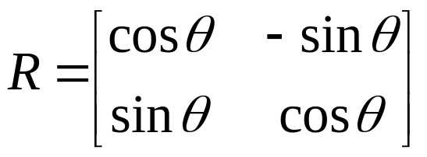
Rotation
We can write the components:
p'_{x} = p_{x} cos θ – p_{y} sin θ
p'_{y} = p_{x} sin θ + p_{y} cos θ
or in matrix form:
P' = R • P
θ can be clockwise (-ve) or counterclockwise (+ve as our example).
Rotation matrix
P’(x’, y’)
θ
y’
P(x,y)
θ
r
y
φ
x’
x

Slide 12
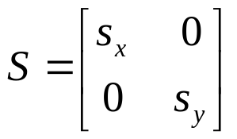
Scaling
Scaling changes the size of an object and involves two scale factors, S_{x} and S_{y} for the x- and y- coordinates respectively.
Scales are about the origin.
We can write the components:
p'_{x} = s_{x} • p_{x}
p'_{y} = s_{y} • p_{y}
or in matrix form:
P' = S • P
Scale matrix as:
P’
P

Slide 13
Scaling
If the scale factors are in between 0 and 1:----
➔ the points will be moved closer to the origin
➔ the object will be smaller.
P(2, 5)
P’
Example :
  P(2, 5), S_{x} = 0.5, S_{y} = 0.5

Slide 14
Scaling
If the scale factors are in between 0 and 1 ➔ the points will be moved closer to the origin ➔ the object will be smaller.
P’
Example :
  P(2, 5), S_{x} = 0.5, S_{y} = 0.5
P(2, 5)
If the scale factors are larger than 1 ➔ the points will be moved away from the origin ➔ the object will be larger.
P’
Example :
  P(2, 5), S_{x} = 2, S_{y} = 2

Slide 15
Scaling
P’
If the scale factors are the same, S_{x} = S_{y} ➔ uniform scaling
Only change in size (as previous example)
If S_{x} ≠ S_{y} ➔ differential scaling.
Change in size and shape
Example : square → rectangle
  P(1, 3), S_{x} = 2, S_{y} = 5
P(1, 2)

Slide 16
General pivot point rotation
Translate the object so that pivot-position is moved to the coordinate origin
Rotate the object about the coordinate origin
Translate the object so that the pivot point is returned to its original position
(x_{r},y_{r})
(b)
Translation of object so that pivot point (x_{r},y_{r}) is at origin
(c)
Rotation was about origin
(d)
Translation of the object so that the pivot point is returned to position (x_{r},y_{r})
(a)
Original Position of Object and pivot point

Slide 17
General fixed point scaling
Translate object so that the fixed point coincides with the coordinate origin
Scale the object with respect to the coordinate origin
Use the inverse translation of step 1 to return the object to its original position
(x_{f},y_{f})
(a)
Original Position of Object and Fixed point
(b)
Translation of object so that fixed point (x_{f},y_{f})is at origin
(c)
scaling was about origin
(d)
Translation of the object so that the Fixed point is returned to position (x_{f},y_{f})

Slide 18
Composite Transformations
(A) Translations
If two successive translation vectors (t_{x1},t_{y1}) and (t_{x2},t_{y2}) are applied to a coordinate position P, the final transformed location P’ is calculated as: -
P’=T(t_{x2},t_{y2}) . {T(t_{x1},t_{y1}) .P}
={T(t_{x2},t_{y2}) . T(t_{x1},t_{y1})} .P
Where P and P’ are represented as homogeneous-coordinate column vectors. We can verify this result by calculating the matrix product for the two associative groupings. Also, the composite transformation matrix for this sequence of transformations is: -
1 0 t_{x2}
0 1 t_{y2}
0 0 1
0 t_{x1}
0 1 t_{y1}
0 0 1
0 t_{x1}+t_{x2}
0 1 t_{y1}+t_{y2}
0 0 1
.
=
Or, T(t_{x2},t_{y2}) . T(t_{x1},t_{y1}) = T(t_{x1}+t_{x2}, t_{y1}+t_{y2})
Which demonstrate that two successive translations are additive.

Slide 19
(B) Rotations
Two successive rotations applied to point P produce the transformed position: -
P’= R(Ө₂) . {R(Ө₁ ) . P}
= {R(Ө₂) . R(Ө₁)} . P
By multiplication the two rotation matrices, we can verify that two successive rotations are additive:
R(Ө₂) . R(Ө₁) = R (Ө₁+ Ө₂)
So that the final rotated coordinates can be calculated with the composite rotation matrix as: -
P’ = R(Ө₁+ Ө₂) . P

Slide 20
(C) Scaling
Concatenating transformation matrices for two successive scaling operations produces the following composite scaling matrix: -
S_{x2} 0 0
0 S_{y2} 0
0 0 1
S_{x1} 0 0
0 S_{y1} 0
0 0 1
S_{x1} . S_{x2} 0 0
0 S_{y1} .S_{y2} 0
0 0 1
.
=
Or, S(S_{x2}, S_{y2} ) . S(S_{x1}, S_{y1}) = S (S_{x1} . S_{x2}, S_{y1} .S_{y2} )
The resulting matrix in this case indicates that successive scaling operations are multiplicative.

Slide 21
Other transformations
Reflection is a transformation that produces a mirror image of an object. It is obtained by rotating the object by 180 deg about the reflection axis
1
Reflection about the line y=0, the X- axis , is accomplished with the transformation matrix
Original position
3
0 0
0 -1 0
0 0 1
2
2’
3’
1’
Reflected position

Slide 22
Reflection
Original position
Reflected position
2
2’
Reflection about the line x=0, the Y- axis , is accomplished with the transformation matrix
1
1’
3
3’
-1 0 0
0 1 0
0 0 1

Slide 23
Reflection
Reflection of an object relative to an axis perpendicular to the xy plane and passing through the coordinate origin
Y-axis
-1 0 0
0 -1 0
0 0 1
Reflected position
3’
2’
1’
The above reflection matrix is the rotation matrix with angle=180 degree.
This can be generalized to any reflection point in the xy plane. This reflection is the same as a 180 degree rotation in the xy plane using the reflection point as the pivot point.
Origin O (0,0)
X-axis
1
2
3
Original position

Slide 24
Reflection of an object w.r.t the straight line y=x
0 1 0
1 0 0
0 0 1
Y-axis
Original position
3
2
1
1’
3’
Reflected position
2’
Origin O (0,0)
X-axis

Slide 25
Reflection of an object w.r.t the straight line y=-x
Y-axis
0 -1 0
-1 0 0
0 0 1
X-axis
Origin O (0,0)
2
3
Original position
1
1’
2’
Line Y = - X
3’
Reflected position

Slide 26
Reflection of an arbitrary axis y=mx+b
Original position
3
2
1

Slide 27
Original position
Translation so that it passes through origin
3
Rotate so that it coincides with x-axis and reflect also about x-axis
Original position
3
2
1
2
1
Original position
2
3
1
1’
Rotate back
Translate back
Original position
Original position
3
Reflected position
3
2’
3’
2
2
1
1
1’
Reflected position
1’
3’
3’
2’
Reflected position
2’

Slide 28
Shear Transformations
Shear is a transformation that distorts the shape of an object such that the transformed shape appears as if the object were composed of internal layers that had been caused to slide over each other
Two common shearing transformations are those that shift coordinate x values and those that shift y values

Slide 29
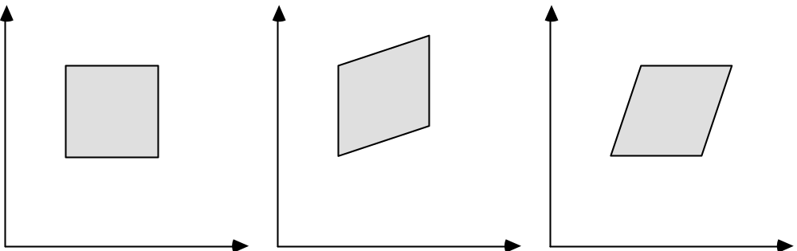
Shears
Original Data y Shear x Shear
1 0 0 1 sh_{x} 0
sh_{y} 1 0 0 1 0
0 0 1 0 0 1

Slide 30
An X- direction Shear
For example, Sh_{x}=2
(2,1)
(3,1)
(0,1)
(1,1)
(0,0)
(1,0)
(0,0)
(1,0)

Slide 31
An Y- direction Shear
For example, Sh_{y}=2
Y
Y
(1,3)
(1,2)
(0,1)
(1,1)
(0,1)
X
X
(0,0)
(1,0)
(0,0)

Slide 32
CONCLUSION
To manipulate the initially created object and to display the modified object without having to redraw it, we use Transformations.

Slide 33
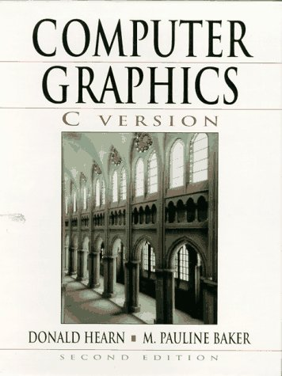
Textbook
Computer Graphics
C Version
  D. Hearn and M. P. Baker
  2nd Edition
  PRENTICE HALL

Slide 34
QUERY ?

Slide 35
THANK YOU ALL

